Slide 1
Travelling Salesman Problem
Solution: Branch and Bound

Slide 2
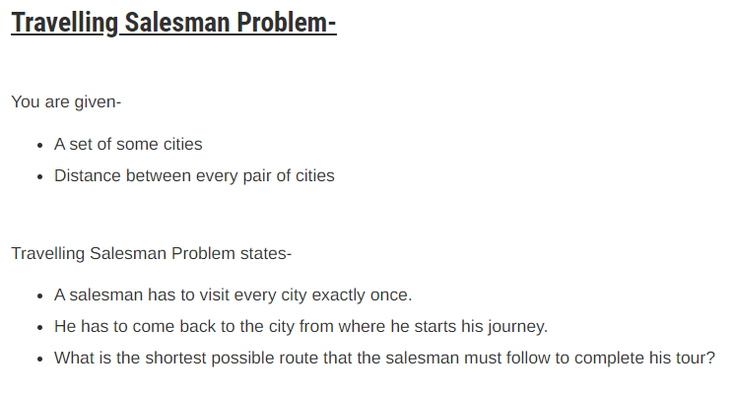

Slide 3
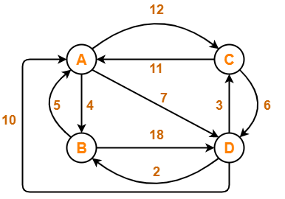
TRAVELLING SALESMAN PROBLEM USING BRANCH AND BOUND
Problem-
Solve Travelling Salesman Problem using Branch and Bound Algorithm in the following graph-

Slide 4
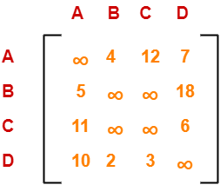
TRAVELLING SALESMAN PROBLEM USING BRANCH AND BOUND
Solution-
Step-01:
Write the initial cost matrix and reduce it-
Rules
To reduce a matrix, perform the row reduction and column reduction of the matrix separately.
A row or a column is said to be reduced if it contains at least one entry ‘0’ in it.

Slide 5
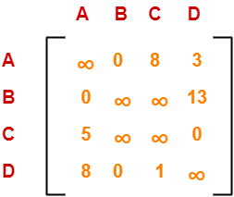
TRAVELLING SALESMAN PROBLEM USING BRANCH AND BOUND
Row Reduction-
Consider the rows of above matrix one by one.
If the row already contains an entry ‘0’, then-
  There is no need to reduce that row.
If the row does not contain an entry ‘0’, then-
  Reduce that particular row.
  Select the least value element from that row.
  Subtract that element from each element of that row.
  This will create an entry ‘0’ in that row, thus reducing that row.
Performing this, we obtain the following row-reduced matrix-

Slide 6
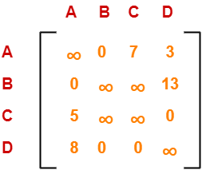
TRAVELLING SALESMAN PROBLEM USING BRANCH AND BOUND
Column Reduction-
Consider the columns of above row-reduced matrix one by one.
If the column already contains an entry ‘0’, then-
  There is no need to reduce that column.
If the column does not contain an entry ‘0’, then-
  Reduce that particular column.
  Select the least value element from that column.
  Subtract that element from each element of that column.
  This will create an entry ‘0’ in that column, thus reducing that column.
Performing this, we obtain the following column-reduced matrix-

Slide 7
TRAVELLING SALESMAN PROBLEM USING BRANCH AND BOUND
Finally, the initial distance matrix is completely reduced.
Now, we calculate the cost of node-1 for state-space tree by adding all the reduction elements.
C(1) = Cost(1)
= Sum of all reduction elements
= 4 + 5 + 6 + 2 + 1
= 18
Now move to Step-2...

Slide 8
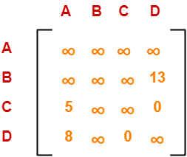
TRAVELLING SALESMAN PROBLEM USING BRANCH AND BOUND
Step-02:
We consider all other vertices one by one.
We select the best vertex where we can land upon to minimize the tour cost.
Choosing To Go To Vertex-B: Node-2 (Path A → B)
From the reduced matrix of step-01, M[A,B] = 0
Set row-A and column-B to ∞
Set M[B,A] = ∞
Now, resulting cost matrix is-

Slide 9

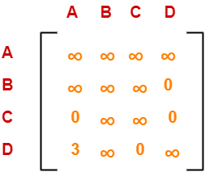
TRAVELLING SALESMAN PROBLEM USING BRANCH AND BOUND
Now,
We reduce this matrix.
Then, we find out the cost of node-02.
Row Reduction-
We can not reduce row-1 as all its elements are ∞.
Reduce all the elements of row-2 by 13.
There is no need to reduce row-3.
There is no need to reduce row-4.
Column Reduction-
Reduce the elements of column-1 by 5.
We can not reduce column-2 as all its elements are ∞.
There is no need to reduce column-3.
There is no need to reduce column-4.

Slide 10
TRAVELLING SALESMAN PROBLEM USING BRANCH AND BOUND
Finally, the matrix is completely reduced.
Now, we calculate the cost of node-2.
C(2) = Cost(2)
= Cost(1) + Sum of reduction elements + M[A,B]
= 18 + (13 + 5) + 0
= 36
Now check remaining paths from A, i.e. A-> C and A-> D

Slide 11
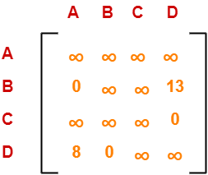
TRAVELLING SALESMAN PROBLEM USING BRANCH AND BOUND
Choosing To Go To Vertex-C: Node-3 (Path A → C)
From the reduced matrix of step-01, M[A,C] = 7
Set row-A and column-C to ∞
Set M[C,A] = ∞
Now, resulting cost matrix is-

Slide 12
TRAVELLING SALESMAN PROBLEM USING BRANCH AND BOUND
Now,
We reduce this matrix.
Then, we find out the cost of node-03.
Row Reduction-
We can not reduce row-1 as all its elements are ∞.
There is no need to reduce row-2.
There is no need to reduce row-3.
There is no need to reduce row-4.
Column Reduction-
There is no need to reduce column-1.
There is no need to reduce column-2.
We can not reduce column-3 as all its elements are ∞.
There is no need to reduce column-4.
Thus, the matrix is already row-reduced.
Thus, the matrix is already column reduced.

Slide 13
TRAVELLING SALESMAN PROBLEM USING BRANCH AND BOUND
Finally, the matrix is completely reduced.
Now, we calculate the cost of node-3.
C(3) = Cost(3)
= Cost(1) + Sum of reduction elements + M[A,C]
= 18 + 0+ 7
= 25
Now check remaining path i.e., A-> D

Slide 14
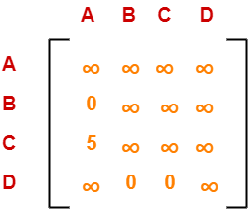
TRAVELLING SALESMAN PROBLEM USING BRANCH AND BOUND
Choosing To Go To Vertex-C: Node-4 (Path A → D)
From the reduced matrix of step-01, M[A,D] = 3
Set row-A and column-D to ∞
Set M[D,A] = ∞
Now, resulting cost matrix is-

Slide 15
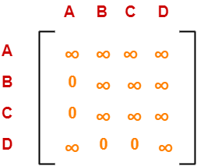
TRAVELLING SALESMAN PROBLEM USING BRANCH AND BOUND
Now,
We reduce this matrix.
Then, we find out the cost of node-04.
Row Reduction-
We can not reduce row-1 as all its elements are ∞.
There is no need to reduce row-2.
Reduce all the elements of row-3 by 5.
There is no need to reduce row-4.
Column Reduction-
There is no need to reduce column-1.
There is no need to reduce column-2.
There is no need to reduce column-3.
We can not reduce column-4 as all its elements are ∞.
Thus, the matrix is already column reduced.

Slide 16
TRAVELLING SALESMAN PROBLEM USING BRANCH AND BOUND
Finally, the matrix is completely reduced.
Now, we calculate the cost of node-4.
C(4) = Cost(4)
= Cost(1) + Sum of reduction elements + M[A,D]
= 18 + 5+ 3
= 26
Thus, we have so far-
Cost(2) = 36 (for Path A → B)
Cost(3) = 25 (for Path A → C)
Cost(4) = 26 (for Path A → D)
We choose the node with the lowest cost.
Since cost for node-3 is lowest, so we prefer to visit node-3.
Thus, we choose node-3 i.e. path A → C.
A
B
C
D
36
25
26

Slide 17
TRAVELLING SALESMAN PROBLEM USING BRANCH AND BOUND
Step-03:
We explore the vertices B and D from node-3.
We now start from the cost matrix at node-3 which is-
Cost(3) = 25

Slide 18
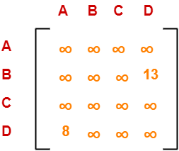
TRAVELLING SALESMAN PROBLEM USING BRANCH AND BOUND
Choosing To Go To Vertex-B: Node-5 (Path A → C → B)
From the reduced matrix of step-02, M[C,B] = ∞
Set row-C and column-B to ∞
Set M[B,A] = ∞
Now, resulting cost matrix is-

Slide 19
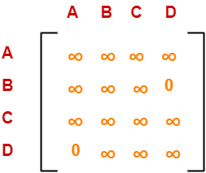
TRAVELLING SALESMAN PROBLEM USING BRANCH AND BOUND
Now,
We reduce this matrix.
Then, we find out the cost of node-5.
Row Reduction-
We can not reduce row-1 as all its elements are ∞.
Reduce all the elements of row-2 by 13.
We can not reduce row-3 as all its elements are ∞.
Reduce all the elements of row-4 by 8.
Column Reduction-
There is no need to reduce column-1.
We can not reduce column-2 as all its elements are ∞.
We can not reduce column-3 as all its elements are ∞.
There is no need to reduce column-4.
Thus, the matrix is already column reduced.

Slide 20
TRAVELLING SALESMAN PROBLEM USING BRANCH AND BOUND
Finally, the matrix is completely reduced.
Now, we calculate the cost of node-5.
C(5) = Cost(5)
= Cost(3) + Sum of reduction elements + M[C,B]
= 25 + (13+8)+ ∞
= ∞
Now check remaining path i.e., A->C-> D

Slide 21
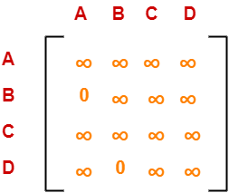
TRAVELLING SALESMAN PROBLEM USING BRANCH AND BOUND
Choosing To Go To Vertex-D: Node-6 (Path A → C → D)
From the reduced matrix of step-02, M[C,D] = ∞
Set row-C and column-D to ∞
Set M[D,A] = ∞
Now, resulting cost matrix is-

Slide 22
TRAVELLING SALESMAN PROBLEM USING BRANCH AND BOUND
Now,
We reduce this matrix.
Then, we find out the cost of node-6.
Row Reduction-
We can not reduce row-1 as all its elements are ∞.
There is no need to reduce row-2.
We can not reduce row-3 as all its elements are ∞.
We can not reduce row-4 as all its elements are ∞.
Column Reduction-
There is no need to reduce column-1.
We can not reduce column-2 as all its elements are ∞.
We can not reduce column-3 as all its elements are ∞.
We can not reduce column-4 as all its elements are ∞.
Thus, the matrix is already column reduced.
Thus, the matrix is already column reduced.

Slide 23
TRAVELLING SALESMAN PROBLEM USING BRANCH AND BOUND
Finally, the matrix is completely reduced.
Now, we calculate the cost of node-6.
C(6) = Cost(6)
= Cost(3) + Sum of reduction elements + M[C,D]
= 25 + 0+0
= 25
A
B
25
C
D
Thus, we have-
Cost(5) = ∞ (for Path A → C → B)
Cost(6) = 25 (for Path A → C → D)
We choose the node with the lowest cost.
Since cost for node-6 is lowest, so we prefer to visit node-6.
Thus, we choose node-6 i.e., path C → D.
36
26
B
D
∞
25

Slide 24
TRAVELLING SALESMAN PROBLEM USING BRANCH AND BOUND
Step-04:
We explore vertex B from node-6.
We start with the cost matrix at node-6 which is-
Cost(6) = 25

Slide 25
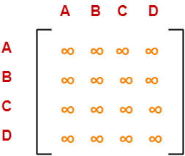
TRAVELLING SALESMAN PROBLEM USING BRANCH AND BOUND
Choosing To Go To Vertex-B: Node-7 (Path A → C → D →B)
From the reduced matrix of step-03, M[D,B] = 0
Set row-D and column-B to ∞
Set M[B,A] = ∞
Now, resulting cost matrix is-

Slide 26
TRAVELLING SALESMAN PROBLEM USING BRANCH AND BOUND
Now,
We reduce this matrix.
Then, we find out the cost of node-7.
Row Reduction-
We can not reduce row-1 as all its elements are ∞.
We can not reduce row-2 as all its elements are ∞.
We can not reduce row-3 as all its elements are ∞.
We can not reduce row-4 as all its elements are ∞.
Column Reduction-
We can not reduce column-1 as all its elements are ∞.
We can not reduce column-2 as all its elements are ∞.
We can not reduce column-3 as all its elements are ∞.
We can not reduce column-4 as all its elements are ∞.
Thus, the matrix is already column reduced.
Thus, the matrix is already column reduced.

Slide 27
TRAVELLING SALESMAN PROBLEM USING BRANCH AND BOUND
Finally, the matrix is completely reduced.
All the entries have become ∞.
Now, we calculate the cost of node-7.
C(7) = Cost(7)
= Cost(6) + Sum of reduction elements + M[D,B]
= 25 + 0 + 0
= 25
A
B
25
C
D
Thus,
Optimal path is: A → C → D → B → A
Cost of Optimal path = 25 units
Note: Among all leaf nodes, this path also has minimum value, so all the other branches are killed.
36
26
B
D
∞
25
B
25

